Slide 1
Chapter 02
Python programming basics, data types
Presenter: Dylan Meng
Date: 04/11/2024
Network & Database Lab
Chungbuk National University
Notes:
A data type refers to anything used as a data type, such as numbers or strings, that are used when programming. The basic and core unit of a program is the data type. To create a calculation program, you first need to know what to calculate, and to create a database program, you first need to know what data to store. It is the most basic of basics. In Chapter 02, we will look at each data type in detail.

Slide 2
Table of Content
1. Number
2. String
3. List
4. Tuple
5. Dictionary
6. Set
7. Boolean
8. Space and variable that store the value of a data type

Slide 3


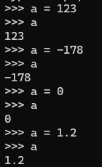
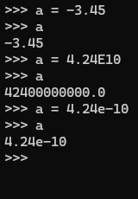
1. Number (1/2)
Number is a data type made up of numbers
A data type made up of numbers
Items | Python Usage Examples
Integer | 123, -345, 0
Floating-point | 123.45, -1234.5, 3.4e10
Octal | 0o34, 0o25
Hexadecimal | 0x2A, 0xFF
Octal: Begins with 0o or 0O
Hexadecimal: Starts with 0x
Octal and hexadecimal are numeric data types that are not often used in Python

Slide 4
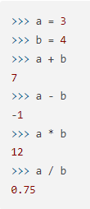
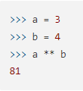
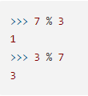

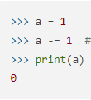
1. Number (2/2)
Operator
Categories | Operators
Four basic operations | +, -, *, /
Represent x to the power of y | **
Return remainder after division | %
Return the quotient after division | //
Compound operators | +=, -=, *=, /=, //=, %=, **=
Notes:
Like a calculator, Python also performs arithmetic operations using operators as follows.

Slide 5

2. String (1/11)
String is a series of consecutive characters.
Surrounded by double quotation marks (").
There are a total of four ways to create strings in Python.
Categories | Examples
Double quotation marks
Single quotation marks
Three double quotation marks
Three single quotation marks

Slide 6
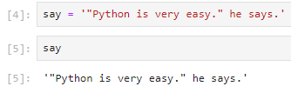
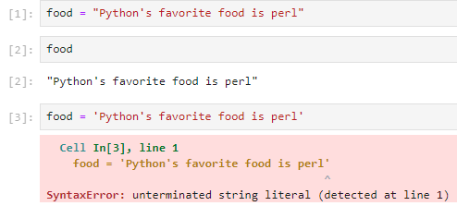
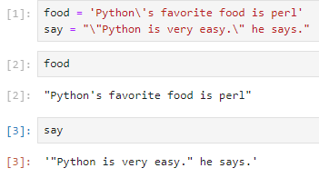
2. String (2/11)
When you want to include single or double quotation marks in a string
1. Including single quotes in strings
2. Including double quotes in strings
3. Including single and double quotes in strings using backslashes
Notes:
If you insert a backslash before a single or double quotation mark, the single or double quotation mark after the backslash does not mean the symbol surrounding the string, but means ' or " itself.

Slide 7
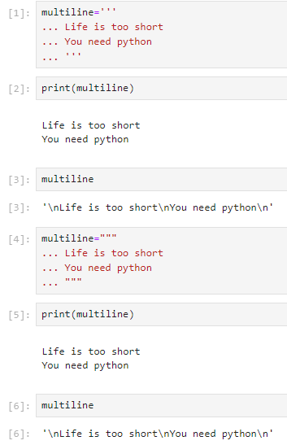
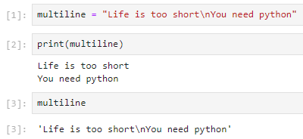
2. String (3/11)
When you want to assign a multi-line string to a variable
1. Insert escape code \n to change lines
2. Use three single or three double quotes in a row

Slide 8
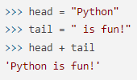






2. String (4/11)
String operations
1. Concatenate by adding strings
2. String multiplication
Find string length
String indexing and slicing
1. String indexing

Slide 9



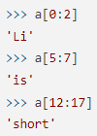








2. String (5/11)
2. String slicing
String formatting
1. Direct insertion of numbers
2. Direct substitution of string
3. Assignment to a variable representing a numeric value
Notes:
As we learned earlier, when substituting a string, you must use double or single quotation marks.

Slide 10
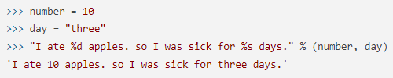

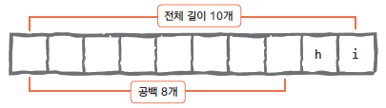

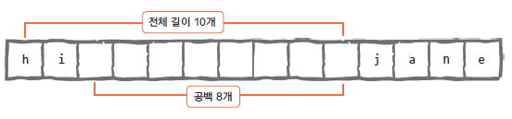
2. String (6/11)
4. Enter 2 or more values
Using format codes and numbers together
1. Alignment and spacing
Code | Explanation
%s | String
%c | Character
%d | Integer
%f | Floating-point
%o | Octal
%x | Hexadecimal
%% | Literal % (Character % Itself)
Notes:
Any type of value can be converted into the %s format code.

Slide 11



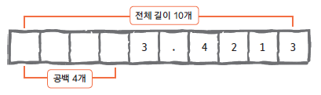


2. String (7/11)
2. Expressing decimal points
Formatting using the format function
1. Substituting number directly
2. Substituting string directly
3. Assigning to Variable with Numeric Value

Slide 12
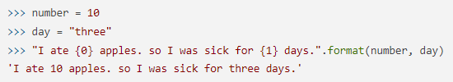



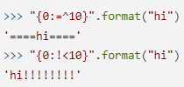
2. String (8/11)
4. Enter 2 or more values
5. Put by name
6. Mixing index and name
5. Left align
6. Right align
7. Center align
8. Fill in the blank

Slide 13

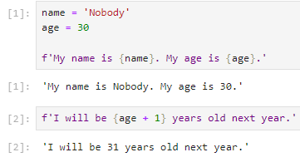
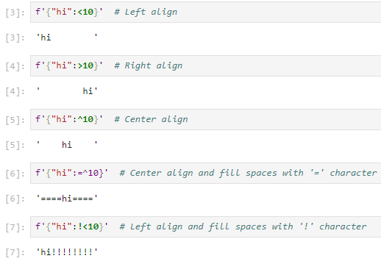


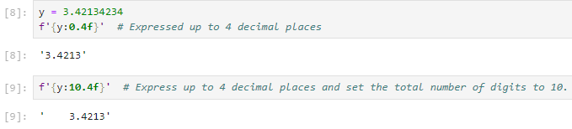

2. String (9/11)
9. Expressing decimal points
10. Expressing { or } characters
f string formatting

Slide 14
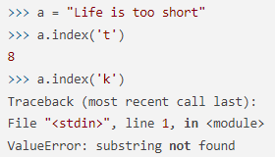

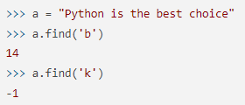


2. String (10/11)
String-related functions
1. Count the number of characters – count
2. Tell location(1) - find
3. Tell location(2) – index
4. Insert string – join
5. Convert lowercase letters to uppercase – upper

Slide 15




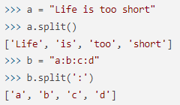

2. String (11/11)
6. Convert uppercase letters to lowercase – lower
7. Clear left space - lstrip
8. Clear right space – rstrip
9. Remove spaces on both sides – strip
10. Replacing a string – replace
11. Splitting a string – split

Slide 16
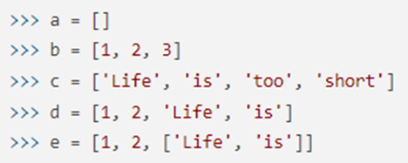

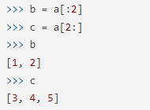

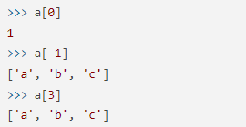





3. List (1/4)
How do you create and use a list?
Indexing and slicing of lists
1. Indexing of lists
2. Slicing of lists
Notes:
Lists, like strings, can be indexed and sliced.

Slide 17






3. List (2/4)
List operations
1. Add list (+)
2. Repeat list (*)
3. Find the length of the list
Editing and deleting of list
1. Modifying values in a list
2. Deleting list elements using the del function

Slide 18
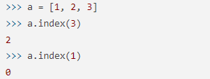










3. List (3/4)
List-related functions
1. Adding elements to a list – append
2. Sorting the list – sort
3. Flip the list – reverse
4. Return index – index
5. Inserting elements into a list – insert
6. Remove list elements - remove
Notes:
As with strings, you can use various list-related functions by adding ‘.’ to the end of the list variable name.

Slide 19
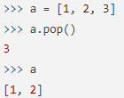
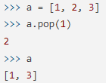
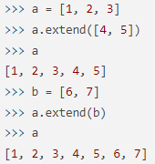

3. List (4/4)
7. Pull out list elements – pop
8. Count the number of elements x included in the list - count
9. List extension - extend

Slide 20
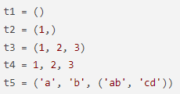
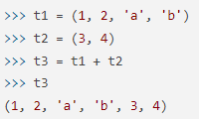

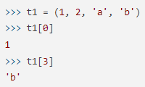


4. Tuple
How to create a tuple?
Tuple handling
1. Indexing
2. Slicing
3. Tuple addition
4. Tuple multiplication
5. Find tuple length
Notes:
A tuple is almost similar to a list except for a few points, and the differences from a list are as follows.
Lists are surrounded by [], and tuples are surrounded by ().
For tuples, the parentheses can be omitted.
Lists can create, delete, and modify element values, but tuples cannot change element values.

Slide 21
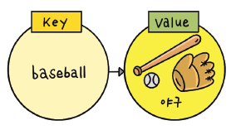
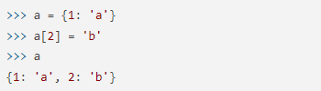



5. Dictionary (1/3)
What is a dictionary?
How to create a dictionary?
Include a list in Value
Adding and deleting dictionary pairs
1. Adding dictionary pairs
2. Deleting dictionary elements
Notes:
Most languages in use these days also have a data type that represents this correspondence relationship, which is called a dictionary, and is also called an ‘associative array’ or a ‘hash’.

Slide 22
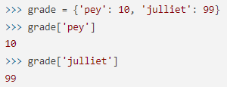

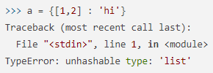
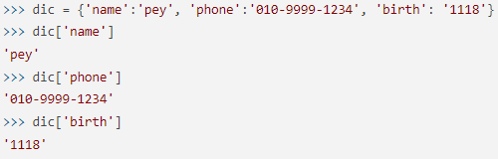
5. Dictionary (2/3)
How to use dictionary
1. Get value using key in dictionary
2. Things to keep in mind when creating a dictionary

Slide 23
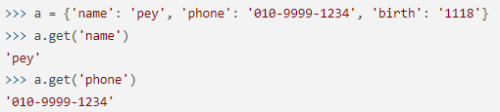


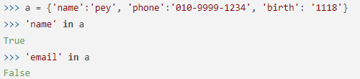

5. Dictionary (3/3)
Dictionary-related functions
1. Creating a Key List – keys
2. Create a list of values – values
3. Get Key, Value pairs – items
4. Clear all Key: Value pairs - clear
5. Get Value with Key – get
6. Check whether the key is in the dictionary - in

Slide 24






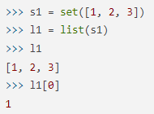

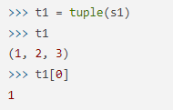
6. Set (1/2)
How to create a set data type?
Characteristics of set data types
Duplication is not allowed.
Unordered.
Finding intersection, union, and difference of sets
1. Find the intersection
2. Find the union
Notes:
A set is a data type created to easily process things related to sets.
Because sets do not allow duplication, they are often used as filters to remove duplication of data.

Slide 25





6. Set (2/2)
3. Find the difference
Set data type related functions
1. Add 1 value – add
2. Adding multiple values – update
3. Removing a specific value - remove

Slide 26







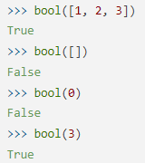
7. Boolean
How to use the Boolean data type?
Boolean operation
Values | True or False
"python" | True
"" | False
[1, 2, 3] | True
[] | False
(1, 2, 3) | True
() | False
Values | True or False
{'a': 1} | True
{} | False
1 | True
0 | False
None | False
Notes:
type(x) is a built-in function in Python that checks the data type of x.

Slide 27
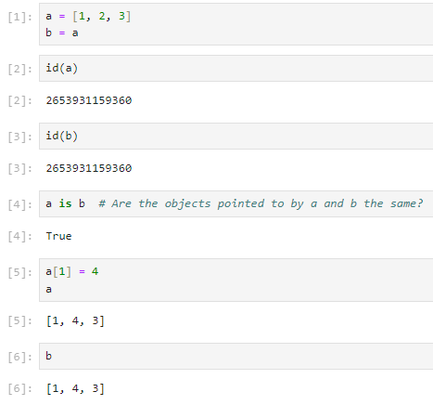



8. Space and variable that store the value of a data type (1/3)
How do we create variables?
Assignment
What is a variable?
Object
When you want to copy a list

Slide 28
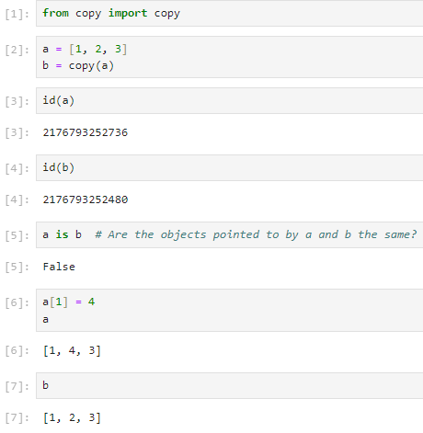
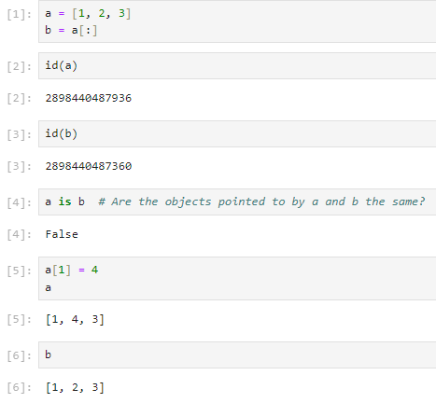
8. Space and variable that store the value of a data type (2/3)
Make variables a and b point to different addresses
1. Use [:]
2. Using the copy module

Slide 29
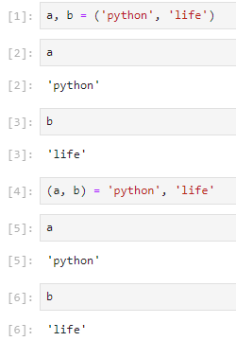
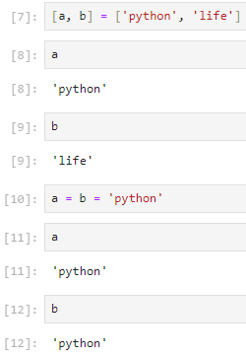

8. Space and variable that store the value of a data type (3/3)
Different ways to create variables

Slide 30


Slide 31
b character
The ‘b‘ character before a string is used to specify the string as a “byte string“. By adding the ‘b’ character before a string literal, it becomes a byte's literal. This means that the string content should be considered as a series of bytes and not characters. Bytes literals are utilized for representing binary data like encoded text, pictures, audio, or any other type of data that may not directly correspond to characters.
String | Byte string
Ordinary strings are human-readable characters that need to be converted to bytes before being stored or processed. | Byte strings are already in byte form and do not need to be converted since computers can only process and store byte data.
Notes:
https://www.geeksforgeeks.org/effect-of-b-character-in-front-of-a-string-literal-in-python/

Slide 32


Slide 33

How are Strings Converted to Bytes?
How is a Byte Object Converted to a String?
Strings are converted to bytes, using encoding. There are various encoding formats through which strings can be converted to bytes.
For e.g., ASCII, UTF-8, etc.…
Use decoding to convert a byte to a string

Slide 34
r character
An ‘r’ before a string tells the Python interpreter to treat backslashes as a literal (raw) character. Normally, Python uses backslashes as escape characters. Prefacing the string definition with ‘r’ is a useful way to define a string where you need the backslash to be an actual backslash and not part of an escape code that means something else in the string.
Notes:
https://packetpushers.net/blog/what-does-an-r-before-a-string-mean-in-python/#:~:text=R%20Means%20'Raw%20String'&text=Normally%2C%20Python%20uses%20backslashes%20as,something%20else%20in%20the%20string.

Slide 35



Notes:
In this example, Python will interpret each ‘\t’ found in this string as a tab. That is, the backslash+t is interpreted as an escape sequence with a special purpose.
By adding the leading r, Python will know that the backslashes are to be interpreted as literal characters and not escape sequences. Interestingly, note how Python represents the literal backslash–as an escape sequence of backslash + backslash.
This means another way to handle the literal backslash problem is to use backslash + backslash in your string definition. However, this feels like a clunkier way to define the string to me when compared to using ‘r’. Using ‘r’ makes for, I think, more readable code.

Slide 36
Supplement
The approach of predefined environment variables in VSCode => How to do in launch.json

Slide 37

Introduction
Visual Studio Code supports variable substitution in Debugging and Task configuration files as well as some select settings. Variable substitution is supported inside some key and value strings in launch.json files using ${variableName} syntax.
More info: https://code.visualstudio.com/docs/editor/variables-reference
Notes:
Visual Studio Code 支持调试和任务配置文件中的变量替换以及一些选择设置。在 launch.json 和 tasks.json 文件中的某些键和值字符串中使用 ${variableName} 语法支持变量替换。

Slide 38
Why use launch.json
Development efficiency:
During the development process, by pre-defining the debug configuration, you can quickly start debugging without manually setting parameters or environment variables each time, thereby improving development efficiency.
Consistency:
When working in a team, by sharing the launch.json file, you can ensure that each developer works in the same debugging environment, reducing problems caused by environmental differences.
Maintainability:
As the project’s complexity increases, the debug configuration may also become complex. Centralizing these configurations in the launch.json file can improve the maintainability and readability of the project.
Notes:
为什么要使用 launch.json
开发效率：
在开发过程中，通过预定义调试配置，可以快速启动调试，无需每次手动设置参数或环境变量，从而提高开发效率。
一致性：
团队协作时，通过共享 launch.json 文件，可以确保每个开发者在相同的调试环境中工作，减少由于环境差异引发的问题。
可维护性：
随着项目的复杂性增加，调试配置也可能变得复杂。将这些配置集中管理在 launch.json 文件中，可以提高项目的可维护性和可读性。

Slide 39
Pros & Cons
Advantages
The debugging process is more convenient and efficient due to predefined.
Since defined separately, it can avoid conflicts and problems that may arise from setting environment variables in the global environment.
Other developers can directly use the same debug configuration without reconfiguring the environment.
A configuration can be used multiple times, reducing the workload of repeated settings.
Disadvantages
Complex for small projects and simple scripts.
Rely on VS Code's debugging features, which may not be available to developers using other editors or IDEs.

Slide 40


Create a launch.json file

Slide 41


Create a launch.json file

Slide 42


Add environment variables

Slide 43


Run Debug

Slide 44
Sharing rescores in Multiprocessing
References
https://docs.python.org/3/library/multiprocessing.html
https://docs.python.org/3/library/multiprocessing.shared_memory.html
https://www.geeksforgeeks.org/python-multiprocessing-queue-vs-multiprocessing-manager-queue/

Slide 45
Overall
multiprocessing.Manager
multiprocessing.Value & multiprocessing.Array
multiprocessing.shared_memory
multiprocessing.Queue
multiprocessing.manager.Queue
Notes:
multiprocessing.Queue ()和multiprocessing.manager().Queue()均用于 Python 的多处理模块中的进程间通信。
两者的主要区别在于 Queue() 使用称为“锁”的同步原语来确保一次只有一个进程可以访问队列，而 manager().Queue() 使用管理器对象来创建可在多个进程之间共享的队列。
The multiprocessing.Queue() and multiprocessing.manager().Queue() are both used for inter-process communication in Python’s multiprocessing module.
The main difference between the two is that Queue() uses a synchronization primitive called a “lock” to ensure that only one process can access the queue at a time, while manager().Queue() uses a manager object to create a queue that can be shared between multiple processes.

Slide 46

multiprocessing.Manager
A manager object returned by Manager() controls a server process that holds Python objects and allows other processes to manipulate them using proxies.
Manager() 返回的管理器对象控制保存 Python 对象的服务器进程并允许其他进程使用代理来操作它们。
Manager()가 반환한 관리자 개체는 Python 개체를 보유하고 다른 프로세스가 프록시를 사용하여 해당 개체를 조작할 수 있도록 하는 서버 프로세스를 제어합니다.

Slide 47

multiprocessing.Value & multiprocessing.Array
Data can be stored in a shared memory map using Value or Array.
可以使用值或数组将数据存储在共享内存映射中。
데이터는 값 또는 배열을 사용하여 공유 메모리 맵에 저장할 수 있습니다.

Slide 48

multiprocessing.shared_memory
For the allocation and management of shared memory to be accessed by one or more processes on a multicore or symmetric multiprocessor (SMP) machine.
用于分配和管理多核或对称多处理器 (SMP) 机器上一个或多个进程访问的共享内存。
멀티코어 또는 대칭형 멀티프로세서(SMP) 시스템에서 하나 이상의 프로세스가 액세스할 공유 메모리를 할당하고 관리하는 데 사용됩니다.

Slide 49

multiprocessing.Queue
The multiprocessing.Queue is a class provided by the multiprocessing module in Python that allows for the creation of a queue that can be used by multiple processes to pass messages to each other.
multiprocessing.Queue 是 Python 中的 multiprocessing模块提供的一个类，允许创建一个队列，多个进程可以使用它来相互传递消息。
multiprocessing.Queue는 Python의 multiprocessing 모듈에서 제공하는 클래스로, 여러 프로세스에서 서로 메시지를 전달하는 데 사용할 수 있는 대기열을 생성할 수 있습니다.

Slide 50

multiprocessing.manager.Queue
The multiprocessing.manager.Queue is a class provided by the multiprocessing module in Python that allows for the creation of a queue that can be used by multiple processes to pass messages to each other.
multiprocessing.manager.Queue 是 Python 中的 multiprocessing模块提供的一个类，允许创建一个队列，多个进程可以使用它来相互传递消息。
multiprocessing.manager.Queue는 Python의 multiprocessing 모듈에서 제공하는 클래스로, 여러 프로세스에서 서로 메시지를 전달하는 데 사용할 수 있는 대기열을 생성할 수 있습니다.

Slide 51

Difference

Slide 52
10. Replacing a string – replace

